Slide 1

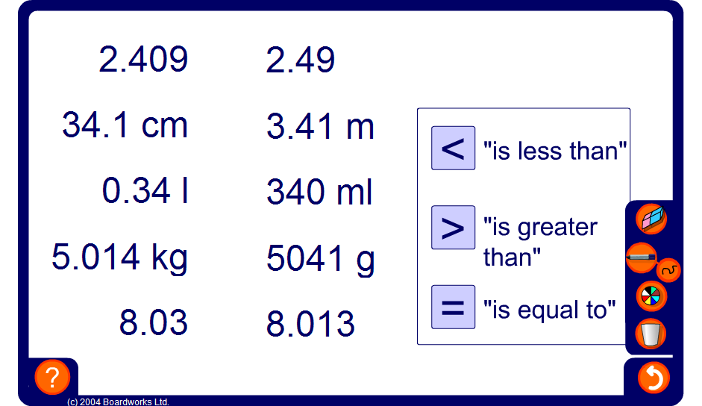


Comparing decimals
Notes:
Drag and drop the correct sign into place. Remind pupils that for the ‘greater than’ and ‘less than’ symbols the open end faces towards the larger number.
You may need to remind pupils of the unit conversions:
There are 1000 grams in a kilogram.
There are 1000 millilitres in a litre.
There are 100 centimetres in a metre.

